Slide 1
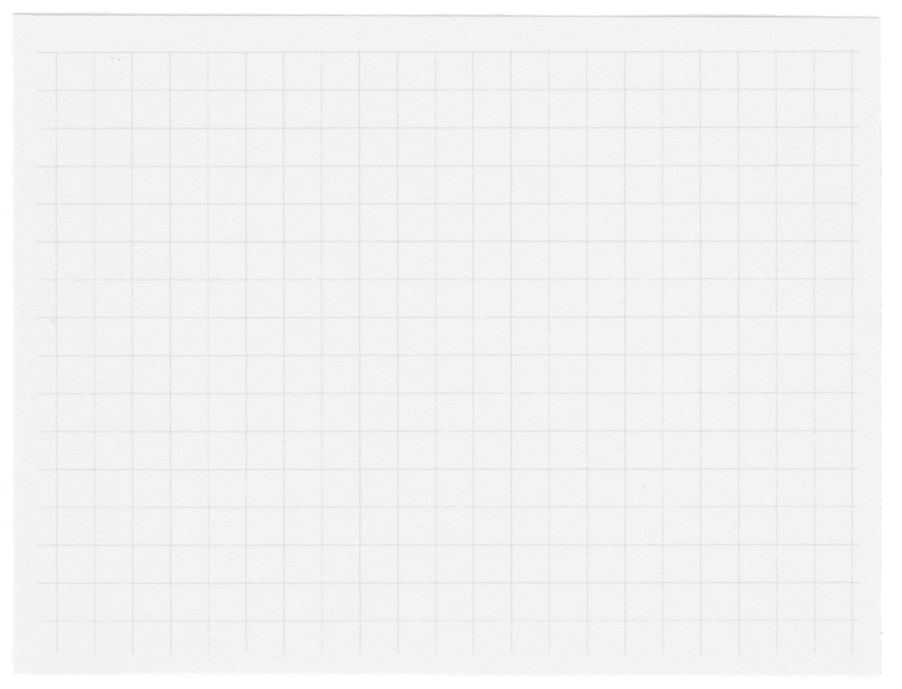

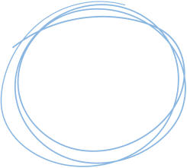











Image Super-Resolution Using SRCNN

Slide 2

Project Overview
Objective: Develop a machine learning-based super-resolution model to restore images to their original quality.
Methods:
Acquire 100 random images from the internet.
Reduce their resolution through blurring or undersampling.
Train a super-resolution model to enhance image quality.

Slide 3
Source: Random images from the internet.
Data Collection
Size: 100 images
Diversity: Various categories to ensure robustness.

Slide 4
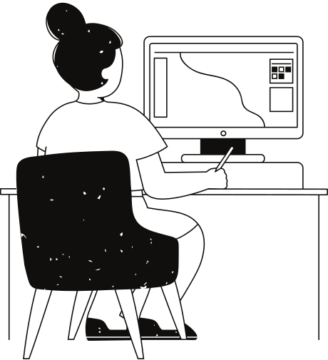
Image Preprocessing
Techniques Used:
Blurring: Applying Gaussian blur.
Undersampling: Reducing the number of pixels.
Purpose: Simulate low-resolution images for training the model.

Slide 5
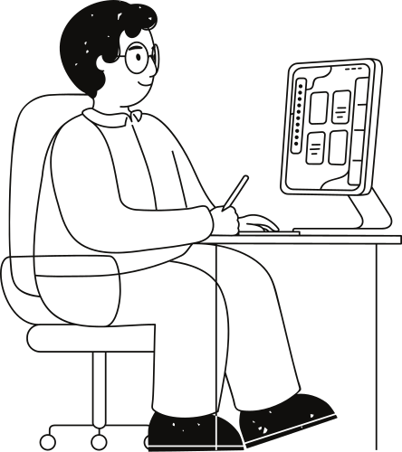
Model Architecture
SRCNN (Super-Resolution Convolutional Neural Network)
Input Layer: Shape (None, None, 3)
Conv Layer 1: 64 filters, kernel size 9x9, ReLU activation
Conv Layer 2: 32 filters, kernel size 1x1, ReLU activation
Conv Layer 3: 3 filters, kernel size 5x5, linear activation (RGB output)

Slide 6
Training the Model
Framework: Google Colab
Training Data: Low-resolution and high-resolution image pairs
Training Details:
Optimizer: Adam
Loss Function: Mean Squared Error (MSE)
Metric: Peak Signal-to-Noise Ratio (PSNR)
Epochs: 10
Batch Size: 32

Slide 7
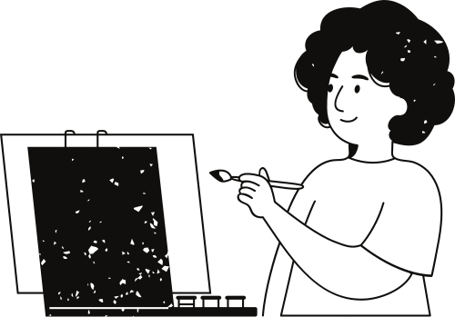
Results
Model Performance:
Accuracy: 67.68%
Visual Comparisons:
Examples of low-resolution, high-resolution, and restored images.

Slide 8
Thank you!

